Slide 1


Parallelized Kalman-Filter-Based Reconstruction of Particle Tracks on Many-Core Processors and GPUs
August 31, 2017
G. Cerati⁴, P. Elmer³, S. Krutelyov¹, S. Lantz², M. Lefebvre³,
M. Masciovecchio¹, K. McDermott², D. Riley², M. Tadel¹, P. Wittich²,
F. Würthwein¹, A. Yagil¹
University of California – San Diego
Cornell University
Princeton University
Fermilab

Slide 2
Outline
Problematic & experimental setup
Overview of the parallelization on x86 processors
Sandy Bridge and Knights Corner
Parallelizing on GPUs
Porting Strategy
Data structures
Track fitting: lessons learned
Track building: increasing the algorithmic complexity
Optimizing data transfer
Alternative parallelization scheme
First results on P100
Issues

Slide 3
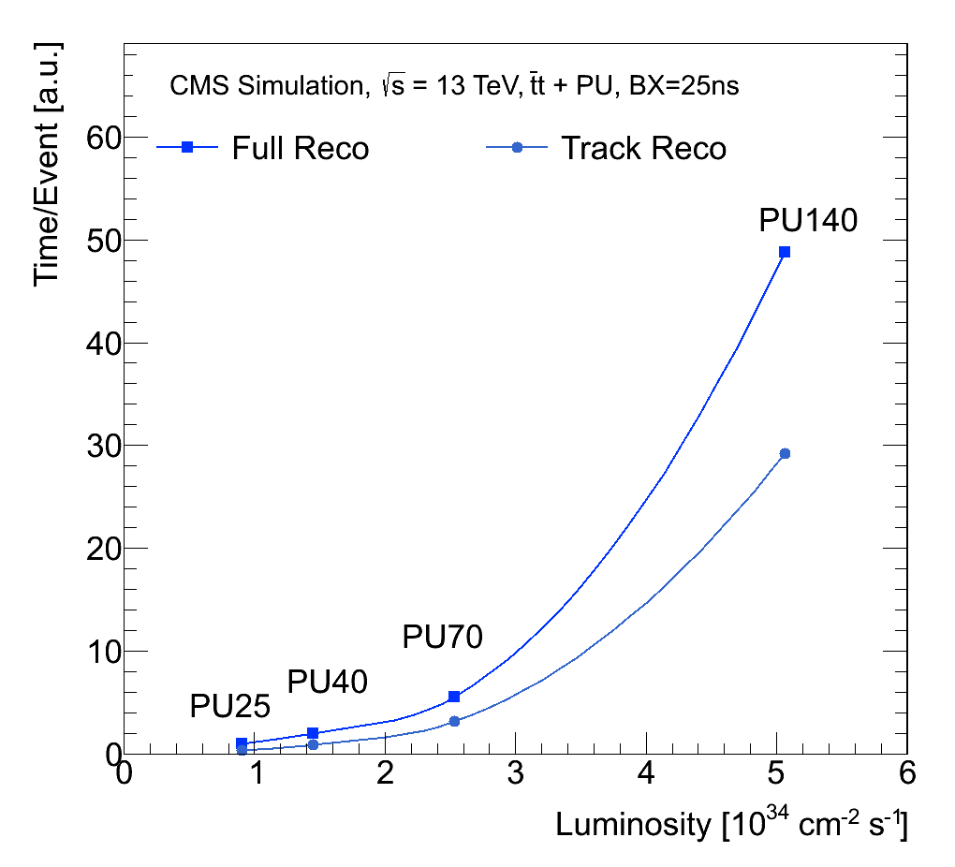
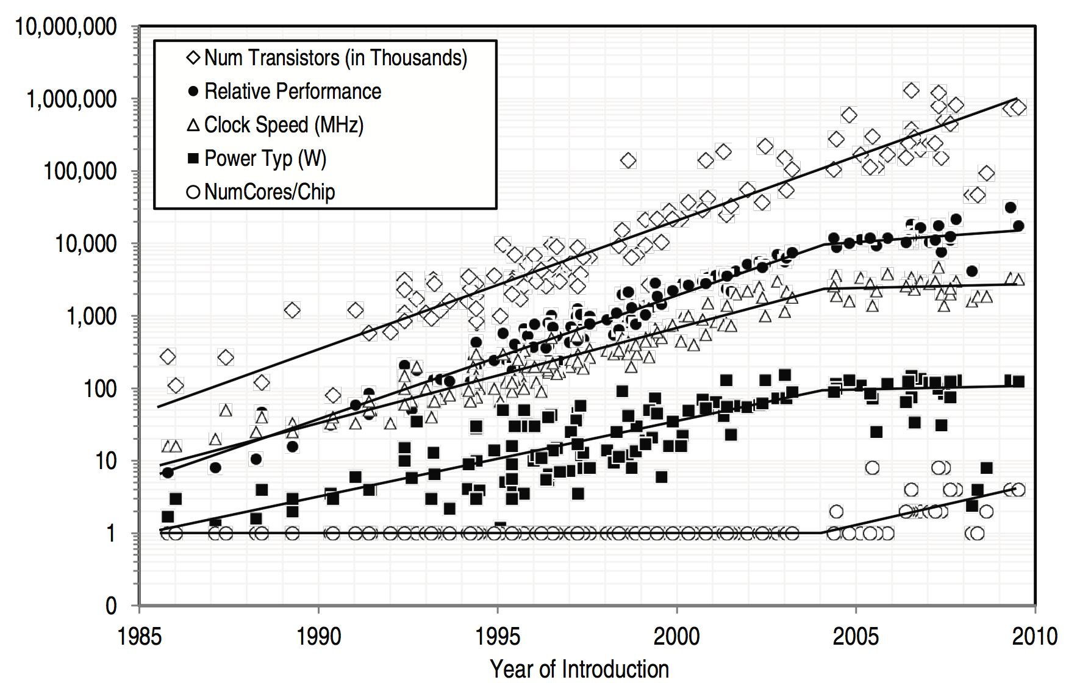
Why Parallelizing?
By 2025, the instantaneous luminosity of the LHC will increase by a factor of 2.5, transitioning to the High Luminosity LHC
Increase in detector occupancy leads to significant strain on read-out, selection, and reconstruction
Clock speed stopped scaling
Number of transistors keeps doubling every ~18 months
Multi-core architectures
E.g. Xeon, MIC, GPUs

Slide 4
KF Track Reconstruction
Tracking proceeds in three main steps: seeding, building, and fitting
In fitting, hit collection is known: repeatedly apply the basic logic unit
In building, hit collection is unknown and requires branching to explore many possible candidate hits after propagation

Slide 5
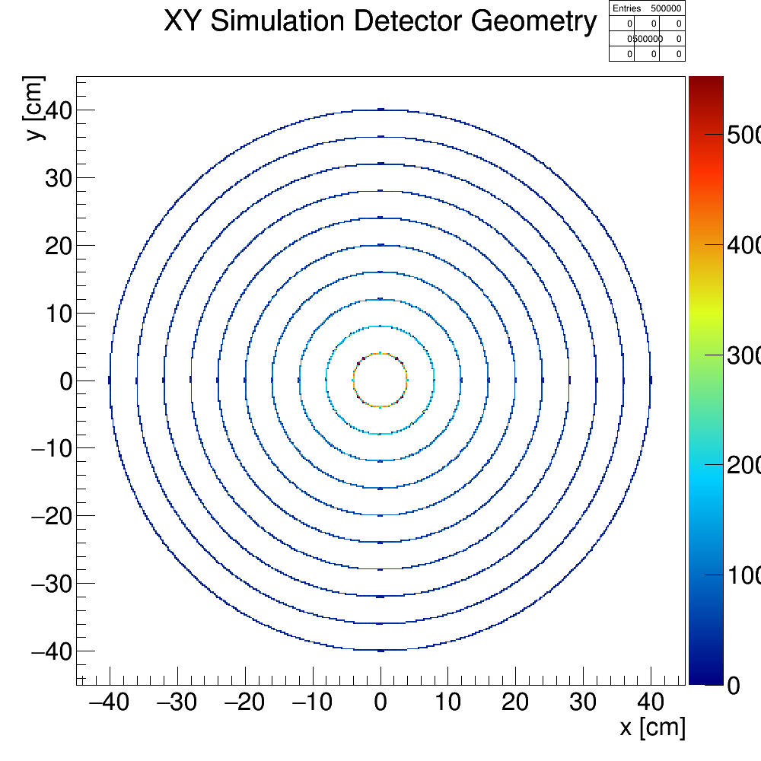
Experimental Setting
Simplified setup
Detector conditions
10 barrel pixel layers, evenly spaced
Hit resolution
σ_{x,y} = 100μm
σ_{z} = 1.0mm
Constant B-field of 3.8T
No scattering/energy loss
Track conditions
Tracks generated with MC simulation uniformly in η,φ (azimuthal angle), and p_{T}
Seeding taken from tracks in simulation
Realistic Setup
Options to add material effects, polygonal geometry:
More realistic setup partially built:
Barrel and Endcap (x86 only)
Notes:
We are not going to talk about the realistic setup as it is not implemented for GPU.

Slide 6
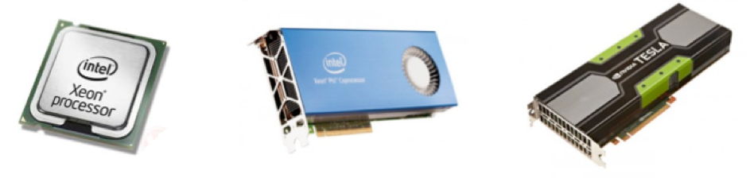
Selected Parallel Architectures
 | Xeon E5-2620 | Xeon Phi 7120P | Tesla K20m | Tesla K40
Cores | 6 x 2 | 61 | 13 | 12
Logical Cores | 12 x 2 | 244 | 2496 CUDA cores | 2880
Max clock rate | 2.5 GHz | 1.333 GHz | 706 MHz | 745 MHz
GFLOPS (double) | 120 | 1208 | 1170 | 1430
SIMD width | 64 bytes | 128 bytes | Warp of 32 | Warp of 32
Memory | ~64-384 GB | 16 GB | 5 GB | 12 GB
Memory B/W | 42.6 GB/s | 352 GB/s | 208 GB/s | 288 GB/s

Slide 7
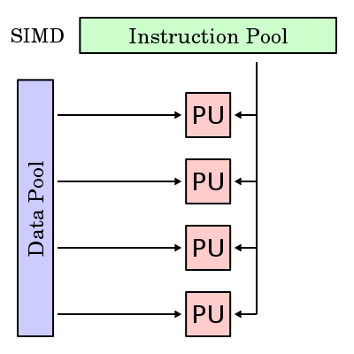
Challenges to Parallel Processing
KF tracking cannot be ported in straightforward way to run in parallel
Need to exploit two types of parallelism with parallel architectures
Vectorization
Perform the same operation at the same time in lock-step across different data
Challenge: branching in track building - exploration of multiple track candidates per seed
Parallelization
Perform different tasks at the same time on different pieces of data
Challenge: thread balancing – splitting the workload evenly is difficult as track occupancy in the detector not uniform on a per event basis
Vectorization

Slide 8
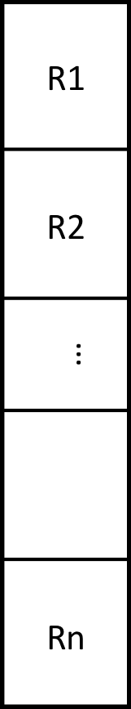

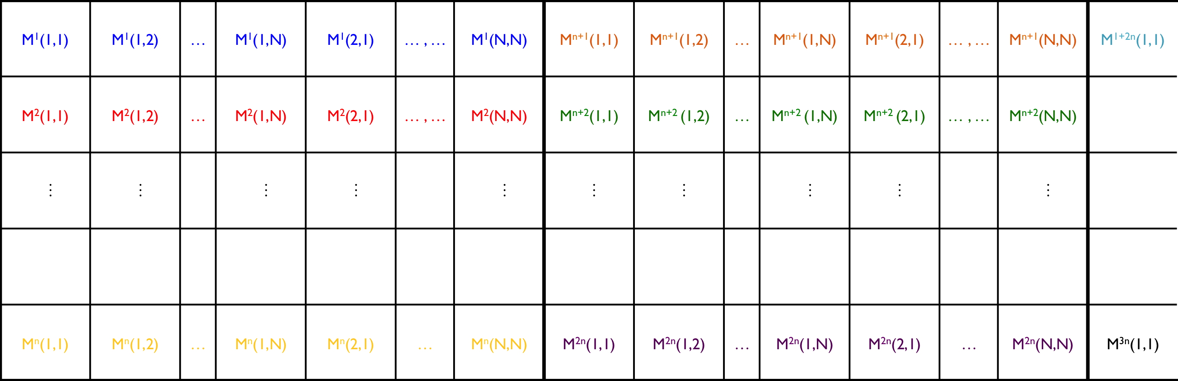
Matriplex
Matrix operations of KF ideal for vectorized processing: however, requires synchronization of operations
Arrange data in such a way that it can loaded into the vector units of Xeon and Xeon Phi with Matriplex
Fill vector units with the same matrix element from different matrices: n matrices working in synch on same operation
fast memory direction
vector
unit
Matrix size NxN, vector unit size n
Notes:
Matriplex, Multiple track cands slides are important not only to introduce the slide with CPU/MIC results but also to introduce the data struct and algorithm; making it easier to understand what had to be done on the GPU side.

Slide 9
Handling Multiple Track Candidates: First Approach
candidates ready
for next layer
sort temp vector, and
clean copies > N
all candidates in layer
for all seeds processed
go to next hit
copy candidate
update with hit
push into temp vector
fail
test χ² < cut
pass
Fail
Pass
Pass
Pass
χ²?
χ²?
χ²?
χ²?
loop over hits in window
N.B. When processing tracks in parallel with Matriplex, copy + update forces other processes to wait!
➔ We need an other approach
propagate candidate to layer

Slide 10
Optimized handling of multiple candidates: “Clone Engine”
candidates still
need update
sort bookkeep list,
copy only the best N
all candidates in layer
for all seeds processed
go to next hit
add entry in bookkeep list
fail
test χ² < cut
pass
N.B. Clone Engine approach should (and does) match physics performance of previous approach!
loop over hits in window
propagate candidate to layer
update candidate with hit from previous step

Slide 11
Track Building: Sandy Bridge and KNC
Toy Monte Carlo experiment
Simplified geometry & simulated events
Similar trends in experiments with realistic geometry & CMSSW events
Scaling tests with 3 building algorithms
Best Hit - less work, recovers fewer tracks (only one hit saved per layer, for each seed)
Standard & Clone Engine - combinatorial, penalized by branching & copying
Two platforms tested
Sandy Bridge (SNB): 8-float vectors, 2x6 cores, 24 hyperthreads
Knights Corner (KNC): 16-float vectors, 60+1 cores, 240 HW threads
Vectorization - speedup is limited in all methods
Faster by only 40-50% on both platforms
Multithreading with Intel TBB - speedup is good
Clone Engine gives best overall results
With 24 SNB threads, CE speedup is ~13
With 120 KNC threads, CE speedup is ~65
KNC
Sandy Bridge
Vectorization
Multithreading
Notes:
Only show Toy MC because it’s the only thing we can show on the GPU. Showing many unrelated things may be confusing

Slide 12




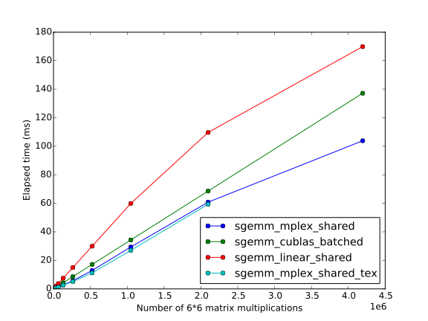
GPU: Finding a Suitable Memory Representation
Memory
Array
“Linear”
”Matriplex”
same strategy as the
one used for CPUs’
vector units.
Threads
Notes:
Non-shared linear version 2 orders of magnitude slower
Coalescent accesses / Aligned data accesses (padded allocation) = group 32 glob. memory accesses together / glob mem access 200-400 cycles

Slide 13
GPU Porting Strategy: An Incremental Approach
Start with fitting:
Share a large number of routines with building
Simpler: less branching, indirections, ….
➔Draw lessons along the way
Gradually increase complexity
”Best Hit”: (at most) 1 candidate per seed
New issues: Indirections, Numerous memory accesses
“Combinatorial”: multiple candidates per seed
New issues: Branching
Notes:
New issues: not “new” per say, “

Slide 14
Fitting: Optimizing Individual Events
10 events @ 20k tracks
For each event:
Reorganize tracks
Transfer tracks
For each layer:
Reorganize hits
Transfer hits
Compute
Transfer partial result back
GPU: K40
GPU
Propagation & Update
Computations
Pre-optimization
Better data access: use read only-cache (const __restrict__)
Merging kernels (reducing launch overhead)
Use registers over shared memory
CPU
Reorganizing data to Matriplex
Numerous indirections
Notes:
Once the proper data structure as been determined, track fitting has been ported to GPU.
Since debugging is particularly unpleasant on the GPU, the process has been to gradually port existing CPU routines to the GPU. This helps checking that everything is working each time something is modified.
Of course, it implies adding CPU/GPU data transfers around each routine and forbid any insights as what the performance of the final port might be.
1.
At some point, all temporary data transfers are removed and only happen at the beginning and at the end of the the fitting process.
This is the initial bar, showing a time of 70ms to fit 10 events of 20K each on a Nvidia Tesla K40 GPU.
2.
From there, the optimization process can begin.
As it has been outlined early one, proper data accesses are critical.
Recent GPUs (at least the ones dedicated to HPC) have read-only cache for data stored in global-memory. It is very similar to what the texture memory and cached were used for; but much simpler to use).
Using this read-only cache, among other things gives a 2-fold improvement.
3.
Kernels (GPU functions called from the CPU) have a limited size and called a large number of time.
This has two undesirable effects
Launching a kernel has some overhead.
Data has to be re-read from global-memory each time a new kernel is launched.
Merging kernels and reducing the number of kernel calls alleviate both issues.
This gives further improvements (bar 3)
4.
Initial kernels were using shared memory (similar to an explicit L2 cache) to store data used several times somewhere closer to the core than global memory.
Usually shared memory is the most useful when data has to be shared between threads of a same block (hence the name).
Going with registers instead shared memory brings some additional gains.

Slide 15
Fitting: Filling up the GPU
Larger Matriplex size
Faster kernels
Longer reorganization
Smaller Matriplex size
“Faster” reorganization
Concurrent events, different streams
Individual kernel instances take longer
Overall time shorter
Compromise:
Find Matriplex size so that time(reorg + transfer + kernel) is minimum
GPU: K40

Slide 16
Track Building: GPU Best Hit
Parallelization: as in Track Fitting
Parallelization: 1 GPU thread per candidate
Reorganizing on the CPU is not an option for building
Frequent reorganizations ➔ very small kernels
Numerous reorganizations ➔no more overlapping possible
Data Structures
Matching CPU and GPU data structures to ease data transfers
Later reorganized as Matriplexes on the GPU
Static containers directly used on the GPU: Hits, Tracks, …
Object composition forces additional trick for classes at the top of the wrapping hierarchy
Keep arrays of sub-objects both on the host and on the device to be able to fill copy sub-objects from the CPU and access them from the GPU.
Data transfer overhead from transferring multiple smaller objects

Slide 17
Track Building: Tuning Parameters
Usual problem, find t_{min} that satisfies:
t_{min} = min f(a, b, c, d)
(a) Number of Eta bins ^{(*)}
(b) Threads per block
(c) Matriplex width
(d) Number of tracks per event
”Standard” insight
“Limited” number of tracks is penalizing
Even more so with newer GPUs
➔Computing multiple events concurrently is mandatory
0.17
0.043 s
10 events @ 20k tracks
0.12
0.043 s
10 events @ 200k tracks
^{(*)} Eta bins: Hits are binned by η to reduced the amount of hits that should be tried for a track .

Slide 18
Building with Multiple Candidates: “GPU Clone Engine”
candidates still
need update
Merged sorted bookkeep lists,
copy only the best N
all candidates in layer
for all seeds processed
go to next hit
add entry in sorted
bookkeep list
fail
test χ² < cut
pass
N.B. Clone Engine approach should (and does) match physics performance of previous approach!
loop over hits in window
propagate candidate to layer
update candidate with hit from previous step
Notes:
Now that we get the “best hit” working we can have a look at the more challenging problem of combinatorial track building. Which is actually the one of interest.
Forced to keep the lists sorted to avoid size growth.

Slide 19
Building with Multiple Candidates
BlockDim.x
ithread
0 | 1 | 2 | 3 | 4 | 5 | 6 | 7 | 8 | 9 | 10 | 11 | 12 | 13 | 14 | 15 | 16 | 17 | 18 | 19
MaxCandsPerSeed = 4
BlockDim.x = 8
itrack
0 | 1 | 2 | 3 | 4 | 5 | 6 | 7 | 8 | 9 | 10 | 11 | 12 | 13 | 14 | 15 | 16 | 17 | 18 | 19
Global Mem.
Old Candidates
Fast-dim
iseed
0 |  |  |  | 1 |  |  |  | 2 |  |  |  | 3 |  |  |  | 4
icand
0 | 1 | 2 | 3 | 0 | 1 | 2 | 3 | 0 | 1 | 2 | 3 | 0 | 1 | 2 | 3 | 0 | 1 | 2 | 3
A Clone-Engine approach is required:
Moving tracks around global memory is guaranteed to be a performance killer
Parallelization: 1 thread per candidate
Other strategies should be investigated (e.g. 1 thread per seed)
Share Mem.
New Candidates*
MaxCandsPerSeed
*Potential next-layer candidates, after adding an acceptable hit from the current layer

Slide 20
Track-based parallelization
sync
1 seed, 4 candidates processed concurrently
4 sets of new candidates
Reduced into 1 set of new candidates
“Map-Reduce-Scatter”
Synchronization across blocks
First layers: only a few candidates per seed for the first layers
idle threads
Also doing concurrent events to better fill the device
sync
sync

Slide 21
Track Building: Initial Performance
20K tracks per event is not enough to give good performance
Need to increase the number of events concurrently fed to the GPU by using different streams
Too many synchronizations
Sorting’s branch predictions
Idling threads when number of candidates per seed is not maximum
Transfer account for 46% of the time

Slide 22
Data Transfer Optimization

Slide 23
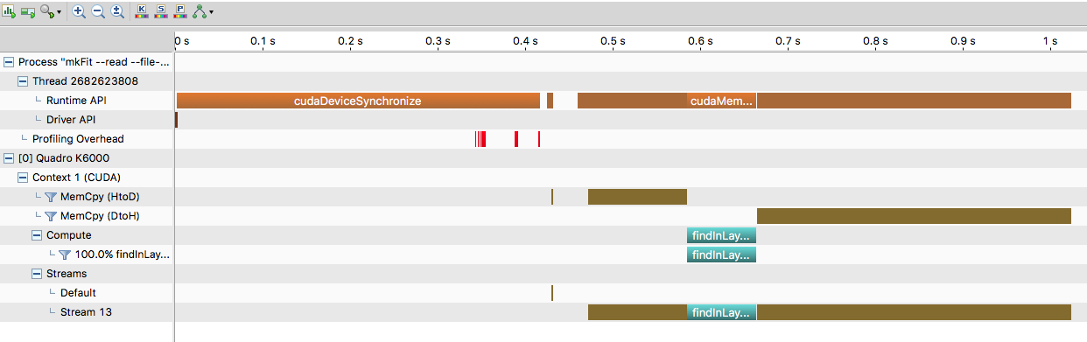
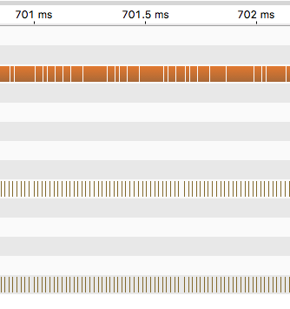
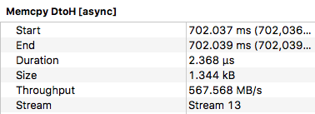
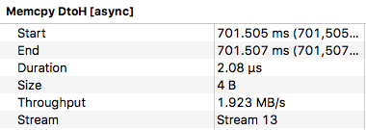
Clone Engine: Timeline
(1) Memcpy > Compute
(2) Zooming in:
Many small transfers
Latency is high
Even if asynchronous
(3) Transfer size:
Ridiculously small
1
2
3

Slide 24
Transfer segmentation / Hierarchical data structure
CPU
GPU
EventCombCand
EventCombCand
1..1
1..1
EtaBinCombCand
EtaBinCombCand
1..1
vector <vector <>>
…
vector <Tracks>
vector <Tracks>
vector <Tracks>
Tracks[]
Data transfers

Slide 25
Temporary Array
EventCombCand
EventCombCand
EtaBinCombCand
EtaBinCombCand
vector <vector <>>
…
vector <Tracks>
vector <Tracks>
vector <Tracks>
Move / Copy
Tracks[]
Tracks[]
“Single” device to host copy

Slide 26
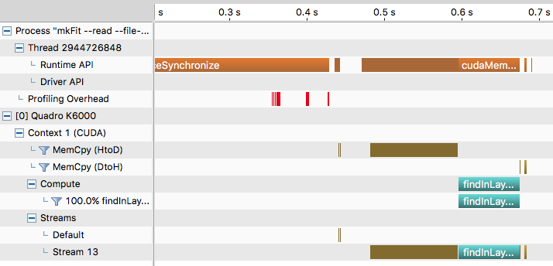
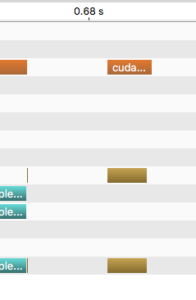
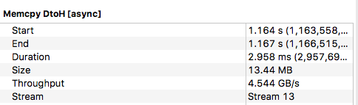
Timeline after transfer bundling

Slide 27
Going Fortran (≤ 77)
EventOfHitsCU
Hit[]
Allocate one big array
On CPU and GPU
Flatten the structure
Bundle transfers
Pre-copy small vectors into the large CPU array
Layers point to these large arrays
Bin[]
…
LayerOfHitsCU

Slide 28
Going back from Fortran
EventOfHitsCU
Hit[]
DeviceBundle
Has a DeviceVector
Avoid spurious alloc / free
Std::Vector::reserve() like operation ➔ reuse allocated array for subsequent events
Bin[]
…
LayerOfHitsCU
DeviceArrayView
Does not have its own memory
Points to a DeviceBundle part

Slide 29
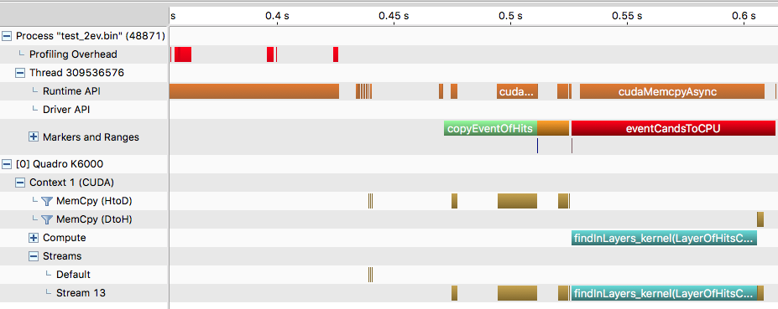
Timeline after Fortran (1 CPU Thread

Slide 30
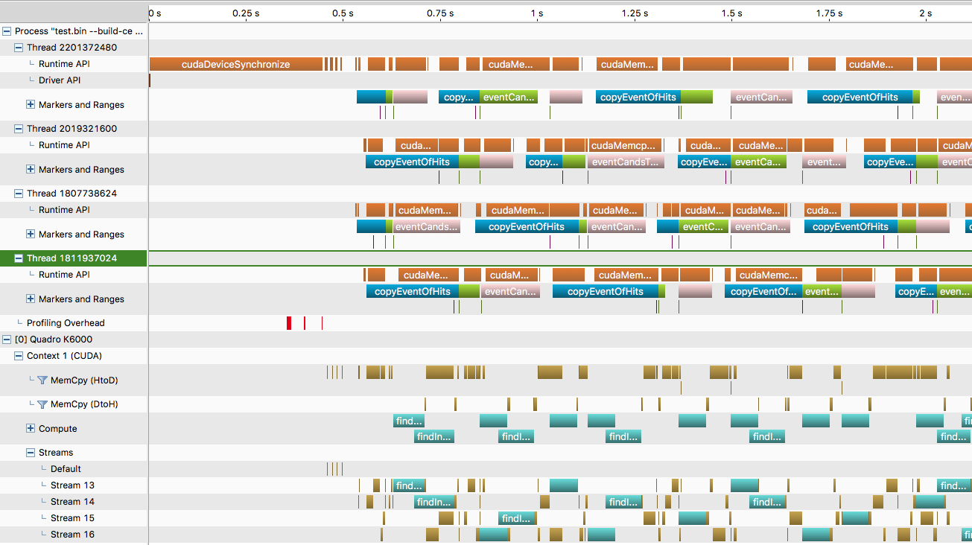
Does it allow events to overlap?
4.97
CtD 1 thread | 4.97 s
1 thread | 3.03 s
4 threads | 2.01 s
Quadro K6000 / Tesla K40

Slide 31
GPU Parallelization Tracks vs. Seeds

Slide 32
Seed-based parallelization
ithread
0 | 1 | 2 | 3 | 4 | 5 | 6 | 7 | 8 | 9 | 10 | 11 | 12 | 13 | 14 | 15 | 16 | 17 | 18 | 19
MaxCandsPerSeed = 4
BlockDim.x = 8
iseed
0 | 1 | 2 | 3 | 4 | 5 | 6 | 7 | 8 | 9 | 10 | 11 | 12 | 13 | 14 | 15 | 16 | 17 | 18 | 19
Global Mem.
Old Candidates
Fast-dim
icand
i | i | i | i | i | i | i | i | i | i | i | i | i | i | i | i | i | i | i | i
itrack = iseed*maxCandsPerSeed + icand
For loop over icand and update heaps.
Heaps are independent
Still in SM
No Sync required (no merge)
Less threads, but more computations per thread
Can we gain something:
Higher compute/mem access ratio ?
Ability to launch concurrent events more efficiently?

Slide 33
Track-based / Seed-based Comparison
20 events @ 10K tracks, from file, Quadro K6000
 |  | Track-based | Seed-based
1 thread | Event-Loop | 3.037 | 3.25
 | Kernel | 1.58 | 1.795
 | HtoD | 0.452 | 0.449
 | DtoH | 0.054 | 0.054
4 threads | Event-Loop | 2.26 | 2.58
 | Kernel | 1.58 | 1.91
 | HtoD | 0.744 | 0.758
 | DtoH | 0.114 | 0.115
10 threads | Event-Loop | 2.08 | 2.33
 | Kernel | 1.62 | 2.03
 | HtoD | 0.786 | 0.856
 | DtoH | 0.112 | 0.118

Slide 34
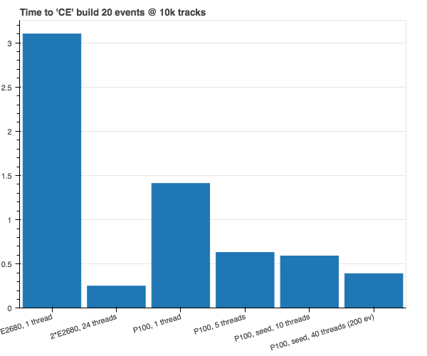
P100 / Broadwell comparison
P100 + Broadwell CPU, PCI-e connection
Seed-based algorithm works better on Pascal
“Scales” better with the number of CPU threads
Track-based freezes when number of CPU threads > 5
Does not freeze on the K6000
Probably due to slurm

Slide 35
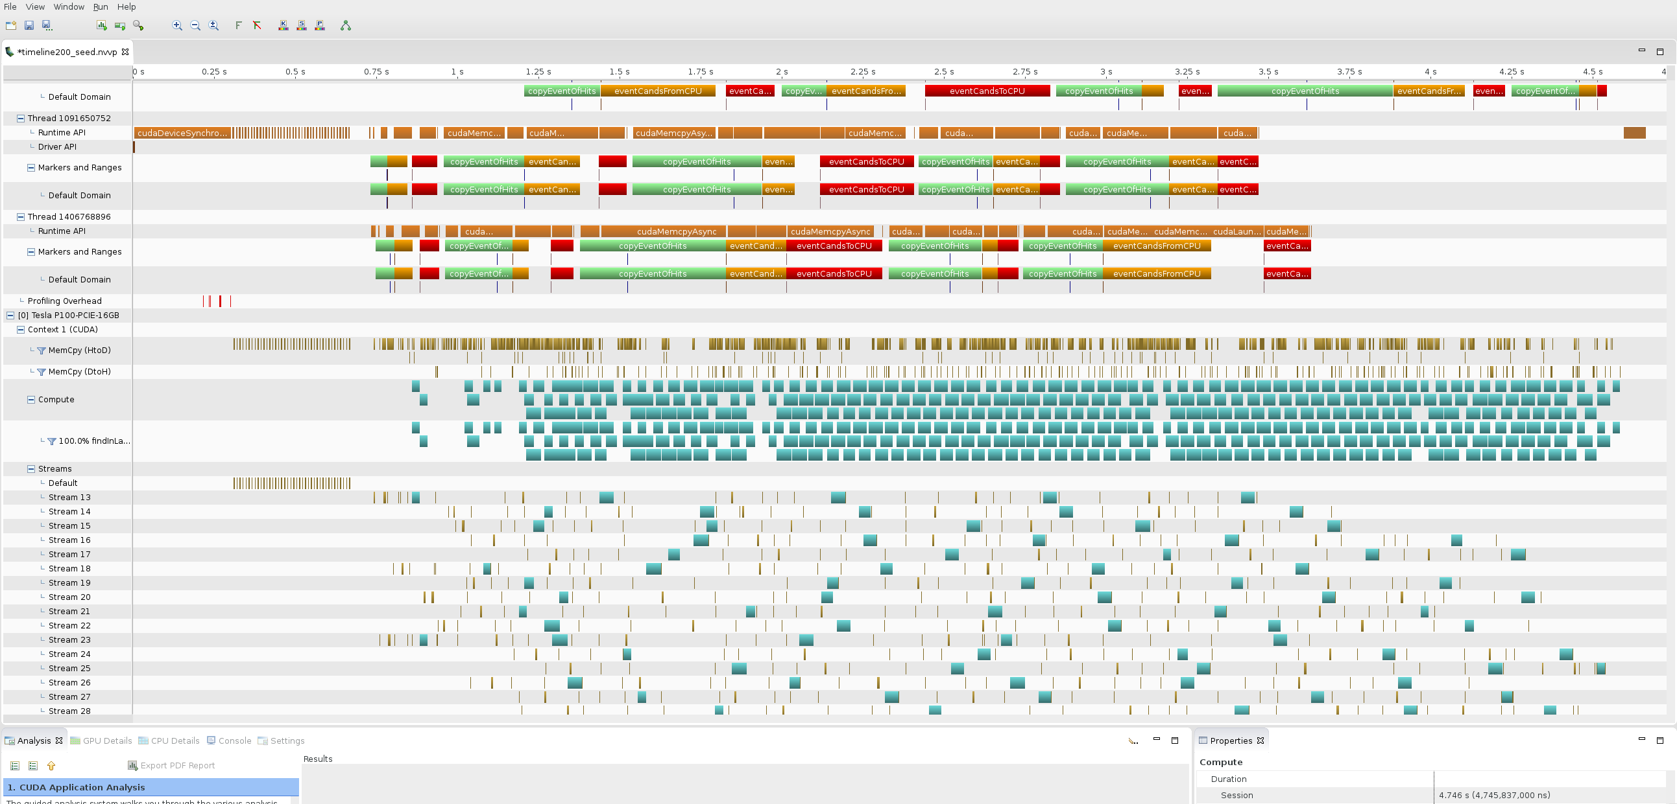
P100, streaming, overlapping
P100-PCIe 200ev @ 10k tracks, 40 CPU threads

Slide 36
Issues (Some)
Latency
Branching
If hit better than worst of current bests
Maintaining heap property: left / right dichotomy
Shared memory
Heaps are too big: 34kB for blocks of 256 threads
Heaps in global mem for track-based algorithm ?
Heap in local mem for seed-based algorithm ?
Hits from hit-loop in SM?
All candidates loops over the same
Track-based heap-merge synchronization
New ”thread_group.sync” in CUDA 9?

